Slide 1
CREDIT EDA ASSIGNMENT PRESENTATION

Slide 2
Problem statement and Data understanding
Understand the given problem statement , and evaluated key points of business objectives.
The datasets namely – 1) application_data II) previous_application
Application data is contains all the information of the client at the time of application, with 122 columns and 307511 rows. Previous Application is historical dataset with 37 columns. and more than 10 lacs rows.
First understand the variables which would play an important role in our analysis , based on that -TARGET would be the common variable. Along with we have start playing and analyzing the univariate, bivariate segmented variables, and prepare the questionnaire , which ideally be part of different phases of analysis .
We have visited problem statements and data sets , multiple times to understand better the variables and there significance in current as well as historical data too.
During our analysis , we have identified variables which would have relationship , and same can consider for Correlation.

Slide 3
Data Cleaning and Manipulation
The same data sets are invoked and read in Jupyter Python Notebook
Find out the columns which are not require, and same dropped .
We have merged both the data sets and assign the same in new DataFrame and then start applying the data cleaning and manipulation activities , the same explained in below points.
Handling the NULL values with median ( we have considered Median , because the accuracy and calculation would be closer).
Handling missing values, with required changes.
Ideally in above steps , we have focused on Data quality issues are addressed in the right way , along with handled data manipulation, where data redundancies identified.
During Data cleaning and manipulation process we have revisited columns which are left(after dropping, unwanted columns), and apply data exploration as well.

Slide 4
Data analysis
Once data cleaning and data manipulation done, moved to next level that is Data Analysis , where identified the univariate and segmented around univariate variables, in this case TARGET. Looking the relationships of the variables , first we need to converted the data from imbalance to balanced categories . Because now we have to consider both the data sets , which we merged in previous step.
Sampling technique is used to make data into balanced categories , where re-execute the previous steps and find out the variables which causes the imbalancing , and due to this data gets imbalanced . We have handled those variables while applying indexing, NumPy random , NumPy concatenate and loc methods.
We have validated balancing ratio analysis in merged data of sampled data.
We have find out the outliers for relational variables. Observed the outliers in Box plot from which percentile the outlier is (25% or 75%) or it is in Interquartile range or above that too. Based on these observations, we have to identified which data points of column we can not consider for next level of analysis.
After this we have considered the Univariate analysis for categorial variables. During this phase pattern reorganization identified.
We have plotted the graphs for those univariate variables which mainly includes - NAME_CONTRACT_TYPE, Gender, FLAG_OWN_REALTY, NAME_TYPE_SUITE, NAME_INCOME_TYPE, Education, Marital Status, Property details, four types of decisions (Approved, Refused, Cancelled, Unused Offer), Payment Mode, Debited date, Loan Enquiry mode, Credit History etc. are the variables considered .

Slide 5
Data analysis
Based on these variables , identified the Quantitative Summary Matrix for considered columns.
After Univariate , we now considered for Bivariate Analysis for identified variable . We have repeat the same steps and observed the impacted areas and of TARGET v/s other variables. We have find out the different correlation matrix . In these observations, we found that some of the variables behaves very positive , some behaves negatively, along with some variables drives at some extent positively and then the line goes down, and then remains constant on data point. Some variables clearly showcased there is no correlation at all.
Conclusion of this analysis is that , we can take positive decision on exact some data points , which are behaving positive , and some of the data points we can clearly reject the loan or there could be less probabilities to repay the loan.
Then we moved to Segmenting data with respect to Target column. We have find out multiple variables which relationally and segment wise playing an important role , which ideally resulted into find out the accurate Correlation and pattern as well.

Slide 6
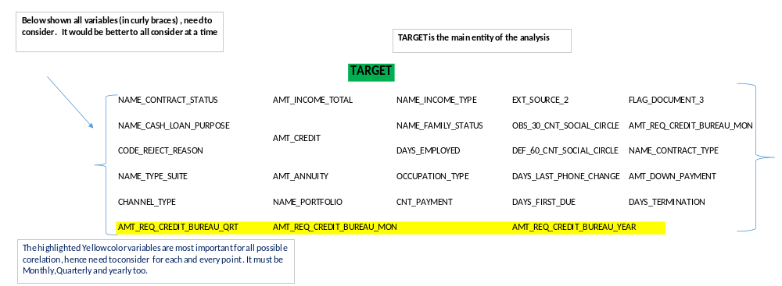
Presentation and Recommendations
Identified Segmented relational variables as -

Slide 7
Presentation and Recommendations
We have then performed operations using Pivot Table on these variables. Based on the result TARGET 2 rows and 49 Columns (attached in separate ipython file) would have maximum positive correlation.
We have plotted HeatMap for better visualization. In HeatMap we have found below observations related to Co relation –
Consideration of Mean of HeatMap two distributions are identified – one goes in upper way which relates positive and other goes down way which states negative correlation.
Below are the variables which highly positive correlation and have healthy pairs , and would be good pattern as well. AMT_ANNUITY,AMT_APPLICATION,AMT_CREDIT,AMT_DOWN_PAYMNET,AMT_GOODS_PRICE,AMT_INCOME_TOTAL,AMT_REQ_CREDIT_BUREAU_MON,QRT,WEEK,CNT_CHILDREN
Below are the variable which has significantly less into positive correlation,but not come under no relation or negative correlation.

Slide 8
Presentation and Recommendations
  AMT_REQ_CREDIT_BUREAU_YEAR,CNT_CHILDREN,CNT_FAM_MEMBERS_CNT_PAYMNET,DAYS_DECISION,DAYS_EMPLOYED,DAYS_FIRST_DUE,DAYS_ID_PUBLISH_DAYS_LAST_DUE,DAYS_LAST_DUE_1ST_VERSION,DAYS_LAST_PHONE_CHANGE,DAYS_REGISTRATION
  The same we have observed for other variables No Correlation and Negative Correlation ( the same visualize in HeatMap graph. Attached ipython file for reference. The same ipython file will be part of Zip file , with this presentation as well).
  Recommendations – Looking and observing the Heatmap , variables which are at close to positive correlation , can consider and applicant repay the loan. Variables which are in between of Mean and full positive correlation can also considered , based on which box is more broad and to which that corelates with ? are the key areas for such variables.
  Variables which are directly at negative values , need not consider for loan application.

Slide 9
Correlation for the Client with Payment Difficulties
  As per predication described in previous slide , to whom can be eligible to repay the loan .
  Now here we have to take insights on the top 10 correlation variables which would causes the payment difficulties with client.
  Looking at HistoGram the Correlation which more on the Negative (down line) , from the mean , can causes the issues with payment.
  We have to consider TARGET as main column and how the other variables play an important role , to find the payment difficulties .
  Below are the 10 variables for the same –
  1)FLAG_WORK_PHONE, 2)LIVE_CITY_NOT_WORK_CITY,3)RATE_INTEREST_PRIMARY,4)RATE_INTEREST_PRIVILEGED,5)SK_ID_PREV,6)AMT_DOWN_PAYMENT,7)AMT_CREDIT,8)AMT_REQ_CREDIT_BUREAU_MON,9) AMT_REQ_CREDIT_BUREAU_QRT,10) SELLERPLACE_AREA

